Slide 1
Physics project work
capacitors
Submitted to : R.p.daila
Submitted by : anant gupta
Class : XII – A
Roll number : 12103
Session : 2020-21

Slide 2
CERTIFICATE
This is to certify that Master Anant Gupta of class
XII-Science Kendriya Vidyalaya Churu has satisfactorily completed the Project on the topic : “CAPACITORS” of the subject physics
,as prescribed by the course and CBSE board this year. I have examined the Project and hereby accord my approval of it as a study carried out and presented in the manner required for its acceptance.

Slide 3
Acknowledgment
I am overwhelmed in all humbleness and gratefulness to acknowledge my deepest gratitude to all those who have helped me put my ideas to perfection and have assigned tasks, well above the level of simplicity and into something concrete and unique i, whole heartedly thank my PHYICS TEACHER respected R.P DAILA sir for having faith in me, for constantly motivating to do better and for your valuable suggestions. He was and will always be there to show me the right track when needed help. With help of his brilliant guidance and encouragement, i was able to complete my tasks properly and was up to the mark in all the tasks assigned. I whole heartedly thank all my classmates working in different projects for helping me evolve better with their critical advice.

Slide 4
coming up
What is a capacitor
Theoretical & mathematical concepts of capacitors
Types of capacitor
How they work
Real world examples

Slide 5
What is a capacitor

Slide 6
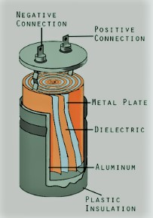
Theoretical definition of capacitors
A capacitor (originally known as a condenser) is a passive two-terminal electrical component used to store energy electrostatically in an electric field.

Slide 7
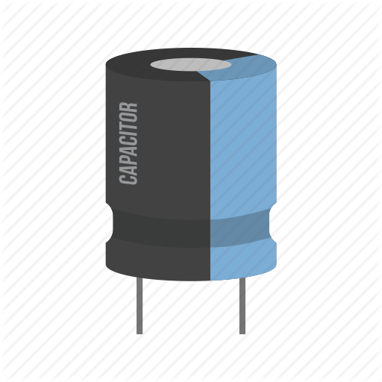
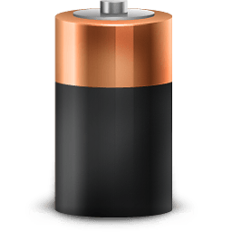
Capacitor
A CAPACITOR STORES ENERGY IN ELECTRIC CHARGE
A capacitor stores electric charge It is little bit like a battery except it stores energy in a different way
A capacitor has energy stored potential energy is stored in the form of an electric field.
Its potential energy is stored in a chemical form
BATTERY
Chemical
⚡ Energy
Electric Storage : Electric Field
It can not store as much energy as a battery although it can charge and release energy much faster. This is very useful and that is why we will find capacitors used in almost very circuit board.

Slide 8
Theoretical & mathematical concepts of capacitors

Slide 9
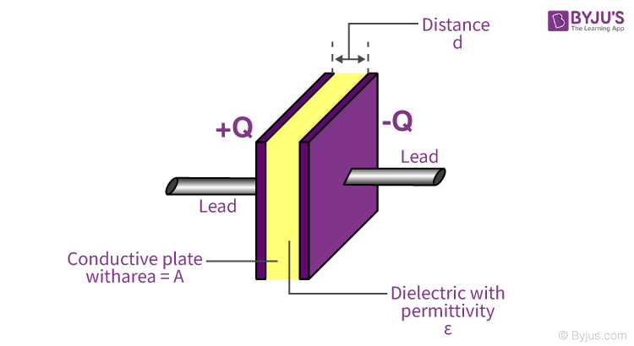
CAPACITANCE
The conducting plates have some charges q1 and q2 (Usually if one plate has +q the other has –q charge). The electric field in the region between the plates depends on the charge given to the conducting plates. We also know that potential difference (V) is directly proportional to the electric field hence we can say,
The ability of the capacitor to store charges is known as capacitance.
Capacitors store energy by holding apart pairs of opposite charges. The simplest design for a capacitor is a parallel plate, which consists of two metal plates with a gap between them. But, there are different types of capacitors manufactured in many forms, styles, lengths, girths, and many materials.
The capacitance of any capacitor can be either fixed or variable depending on their usage.
Q∝V
Q=CV
C=QV
This constant of proportionality is known as the CAPACITANCE of the capacitor.
From the equation, it may seem that ‘C’ depends on charge and voltage. Actually, it depends on the shape and size of the capacitor and also on the insulator used between the conducting plates

Slide 10
Energy Stored in a Capacitor
Once the opposite charges have been placed on either side of a parallel-plate capacitor, the charges can be used to do work by allowing them to move towards each other through a circuit. The total energy that can be extracted from a fully charged capacitor is given by the equation:
U=1/2*C*V*2
Capacitors function a lot of like rechargeable batteries. The main difference between a capacitor and a battery lies in the technique they employ to store energy. Unlike batteries, the capacitor’s ability to store energy doesn’t come from chemical reactions, rather from the physical design that allows it to hold negative and positive charges apart.

Slide 11
Standard Units of Capacitance
The basic unit of capacitance is Farad. But, Farad is a large unit for practical tasks. Hence, capacitance is usually measured in the sub-units of Farads such as micro-farads (µF) or pico-farads (pF).
Most of the electrical and electronic applications are covered by the following standard unit (SI) prefixes for easy calculations:
1 mF (millifarad) = 10⁻³ F
1 μF (microfarad) =10⁻⁶ F
1 nF (nanofarad) = 10⁻⁹ F
1 pF (picofarad) = 10⁻¹² F

Slide 12
Factors Affecting Capacitance
Dielectric
The effect of dielectric on capacitance is that the greater the permittivity of the dielectric the greater the capacitance, likewise lesser the permittivity of the dielectric the lesser is the capacitance. Some materials offer less opposition to the field flux for a given amount of field force. Materials with greater permittivity allow more field flux, hence greater charge is collected.
Plate Spacing
The effect of spacing on the capacitance is that it is inversely proportional to the distance between the plates.
Mathematically i:
C∝1d
Area of the Plates
The effect of the area of the plate is that the capacitance is directly proportional to the area. Larger the plate area more is the capacitance value. Mathematically it is given as:
C∝A

Slide 13
Types of capacitors

Slide 14
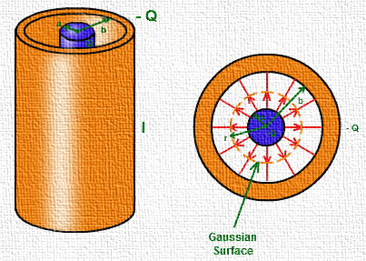
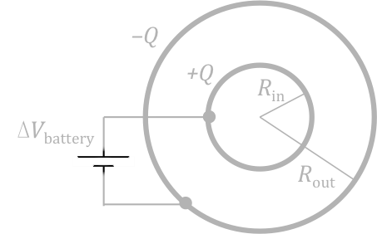
CYLINDRICAL CAPACITOR
SPHERICAL CAPACITOR
Consider a solid cylinder of radius, a surrounded by a cylindrical shell, b. The length of the cylinder is l and is much larger than a-b to avoid edge effects. The capacitor is charged so that the charge on inner cylinder is +Q and outer cylinder is –Q.
Let’s consider a spherical capacitor that consists of two concentric spherical shells. Suppose the radius of the inner sphere, Rin = a and radius of the outer sphere, Rout = b. The inner shell is given a positive charge +Q and the outer shell is given –Q.

Slide 15
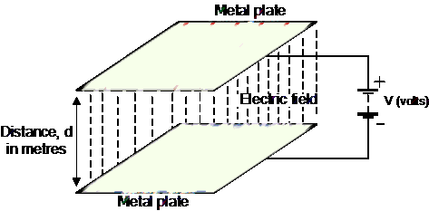
PARALLEL-PLATE CAPACITOR

Slide 16
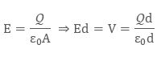
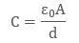
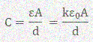
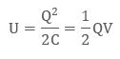
The parallel plate capacitor consists of two metal plates of Area, A and is separated by a distance d. The plate on the top is given a charge +Q and that at the bottom is given the charge –Q. A potential difference of V is developed between the plates.
Dielectric Material Inserted between Two Plates
Charge on Parallel Plate Capacitor

Slide 17
Explaining the working and purpose of capacitor

Slide 18
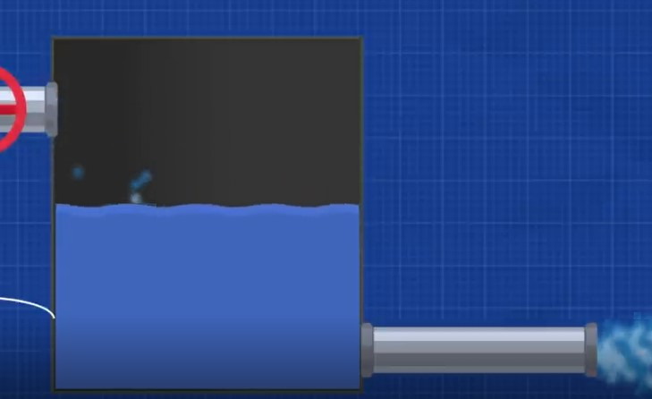
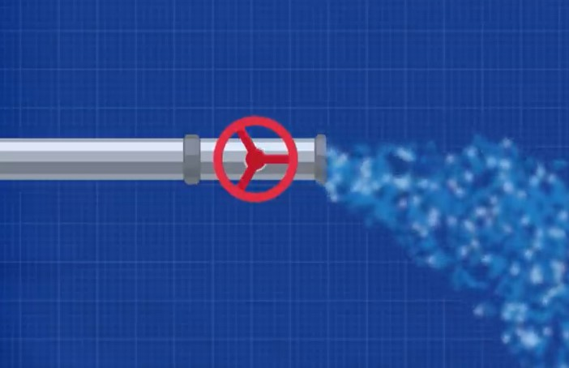
To understand the working of capacitor easily think of a water pipe with water flowing through it the water will continue to flow until we turn the valve off ,then water will stop flowing. However if after the tap we let the water flow into a tank the tank will first fill and store some water and then we continue to get water flowing out of the pipe. Now if we close the valve water will stop pouring into tank but we still get a study supply of water as long as the complete tank is not empty we get an uninterrupted supply of water . The same is the function of capacitor in electrical circuit
Storage tank analogous to capacitor

Slide 19
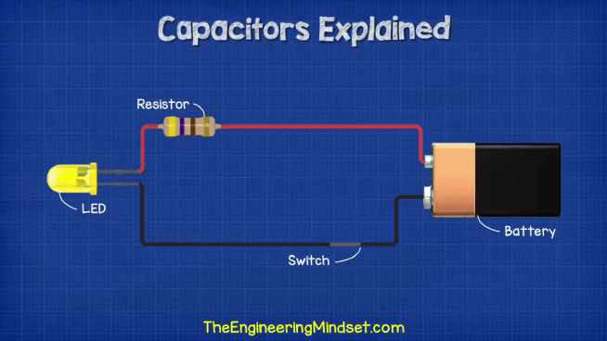
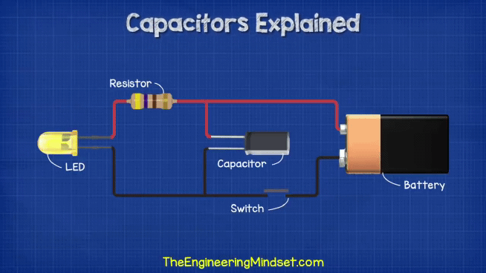
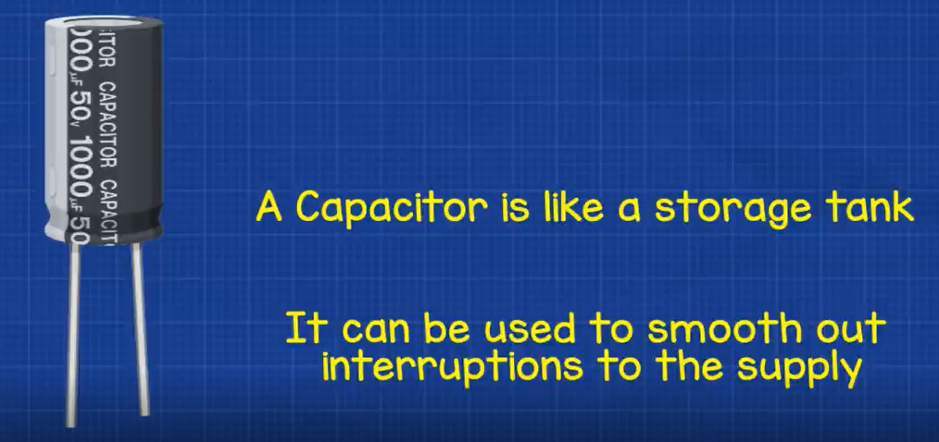
1. Without capacitor
2. With capacitor
If we turn a simple circuit on and off very fast without capacitor then LED in circuit will flash but with capacitor LED would remain glowing on atleast for a short duration because the capacitor is now discharging and giving power to circuit when disconnected form battery as shown in the above circuit .
(Pls view in slideshow)

Slide 20
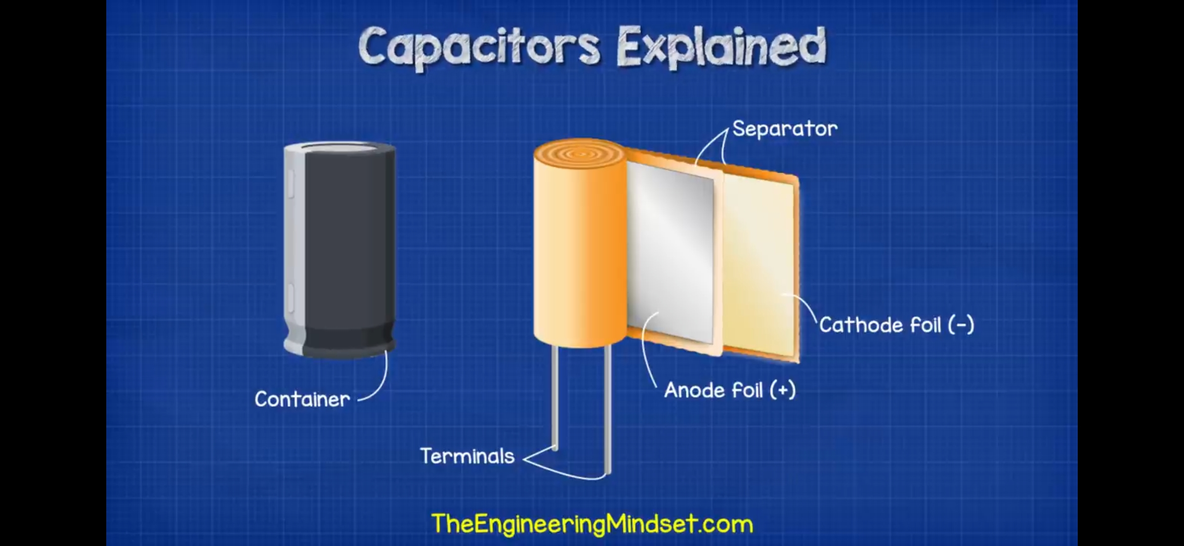
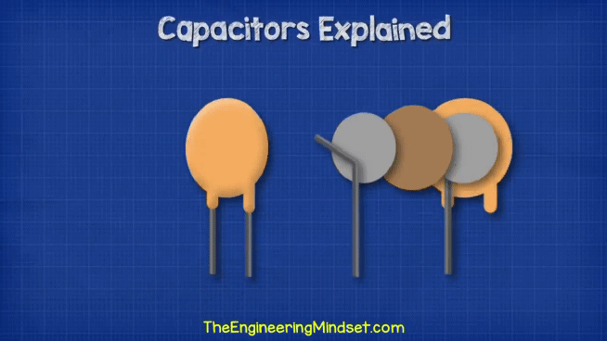
INSIDE A BASIC CAPACITOR (CYLINDRICAL)
Inside a basic capacitor we have two metal connecting plate which are typically made from aluminum and these will be separated by dielectric insulating material such as ceramic.
Di electric means the material will polarise when in contact with an electric field.
(View in slideshow mode please)

Slide 21
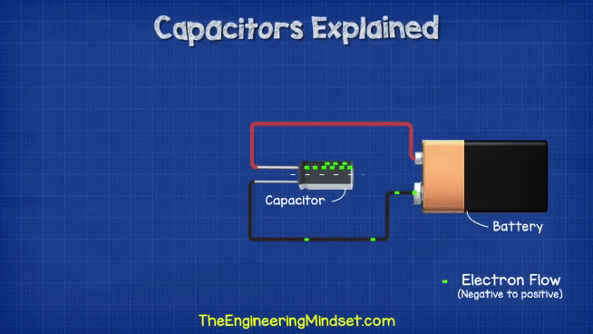
Capacitor in circuit
One side of the capacitor is connected to the positive side of battery and the other side to the other terminal of battery. Strip and a symbol indicates that side of terminal. When connected with battery the voltage will push electrons from –ve terminal to capacitor, electron will build up on one plate while other plate in turn releases some electrons. Electrons cant pass through capacitor because of insulating material therefore there is a build up of electrons on one side. This means we have stored energy and we can use it later on.
Now as we have electrons build up one side the other side is +ve and there is a potential difference between the two terminals
(Pls view in slideshow)

Slide 22
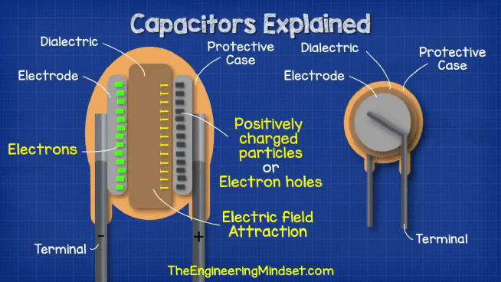
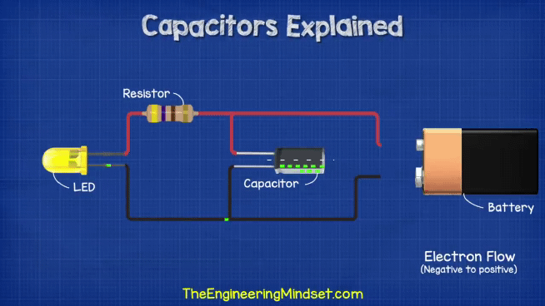
Like magnets attracts towards their negative pole. The same occurs with the negatively charged electrons they are attracted to the positively charges on other plate but they can never meet due to dielectric insulation . This pull between two sides is an electric field which holds electrons until another possible path is made .
When placed in a circuit now an possible path exist to flow and reach the opposite side so the electrons will flow through the LED and reach the other side but this only lasts for last until build is equal on both sides .
(Please view in slideshow)

Slide 23
Real world examples with explanation

Slide 24
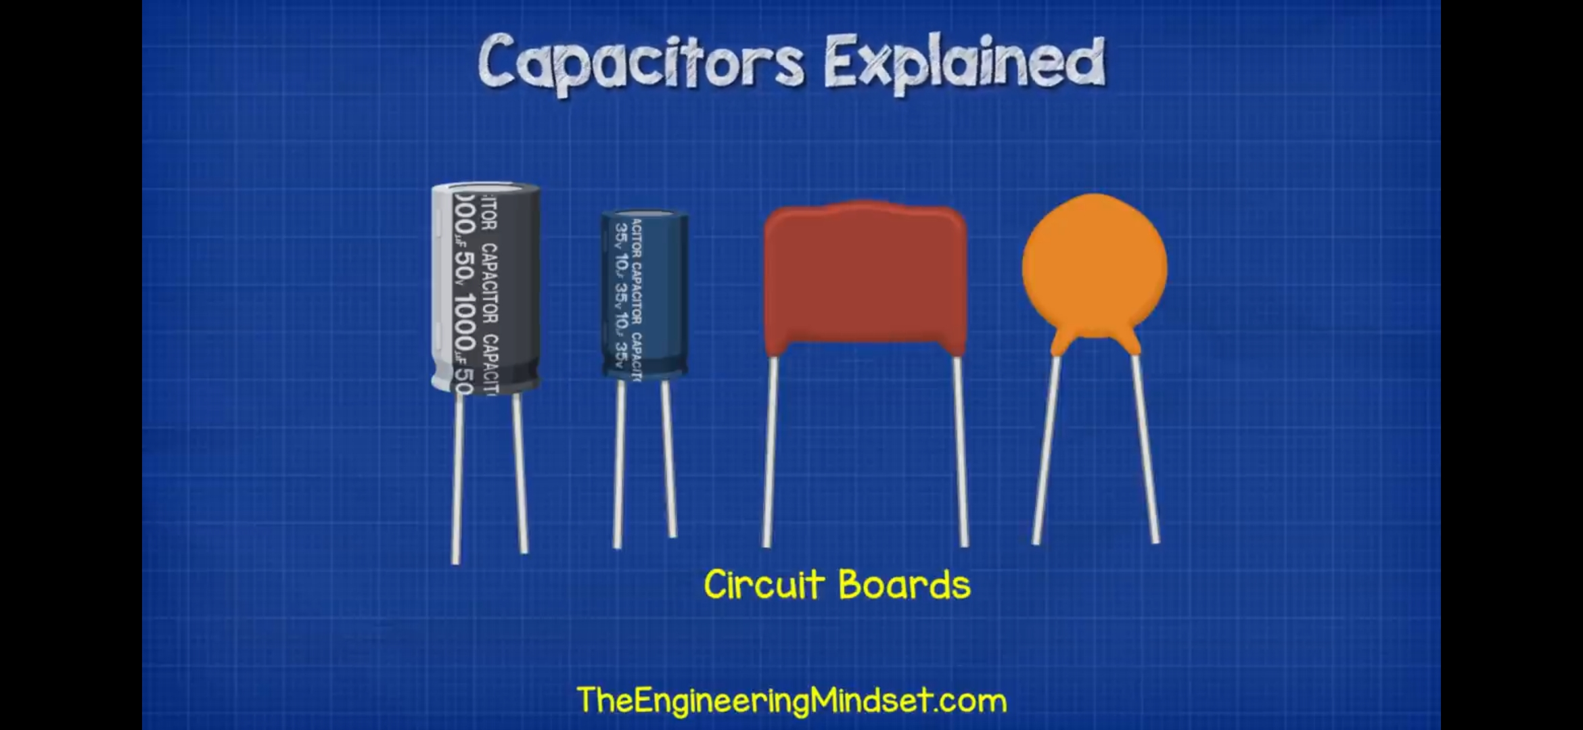
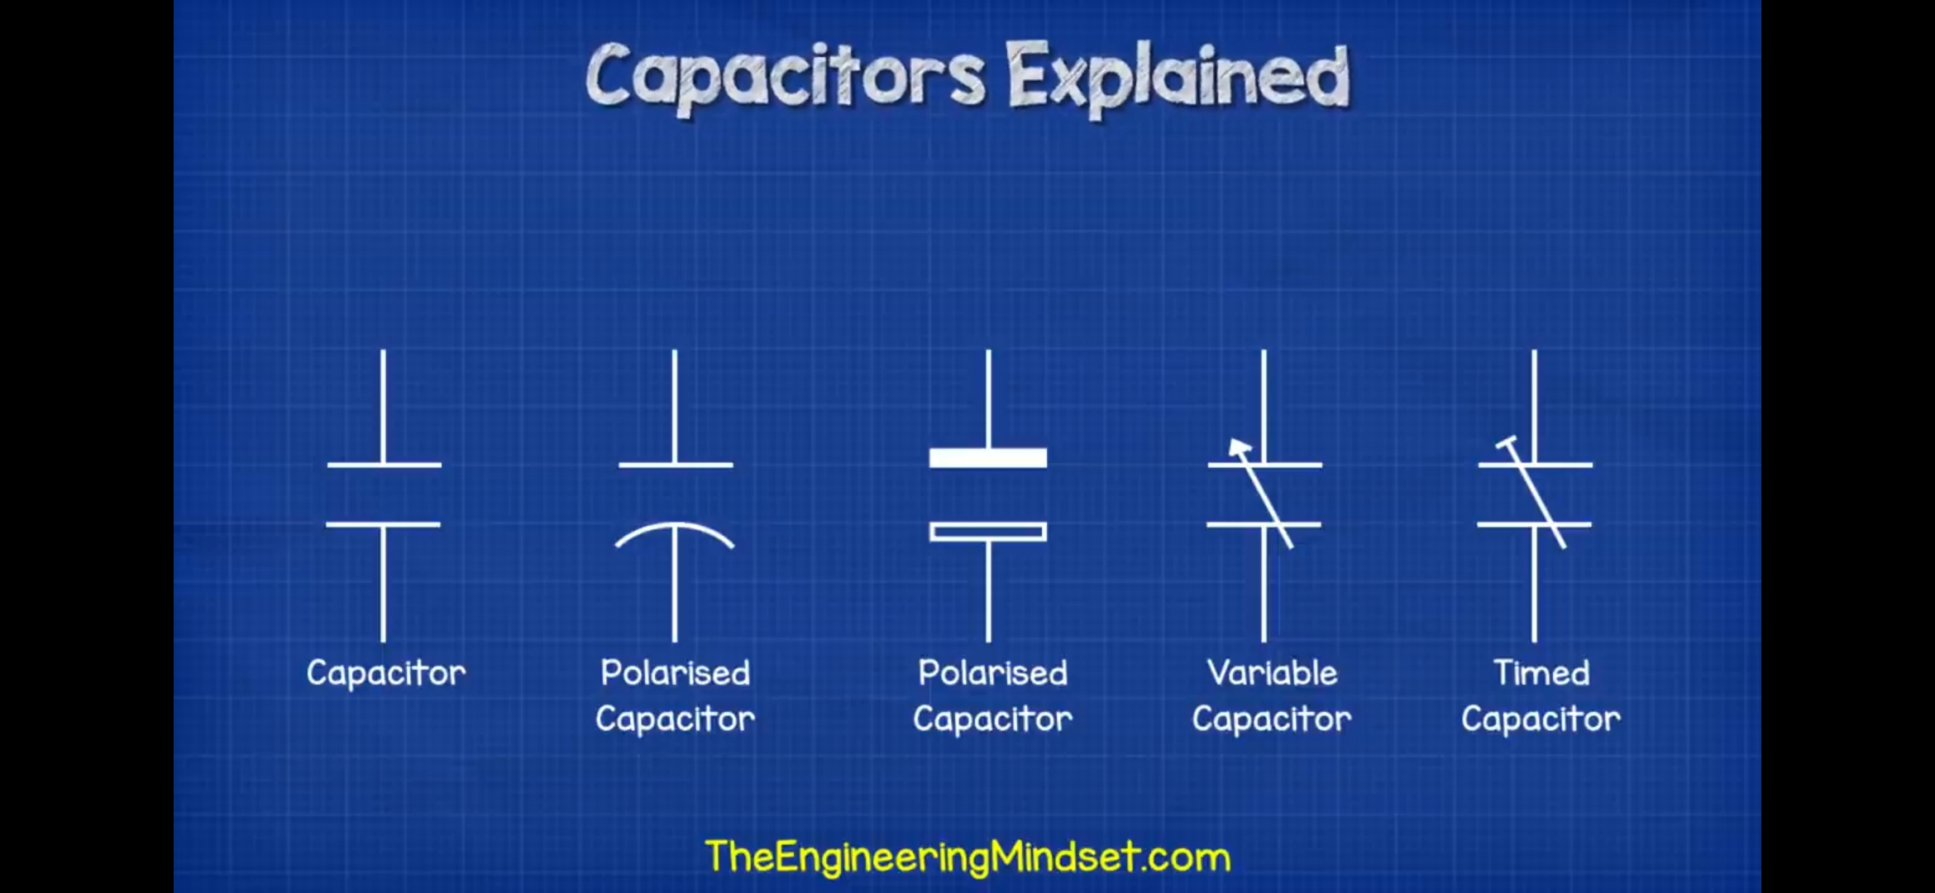
Use of capacitors
In circuit board
Represented in circuit drawings
Larger capacitors can be seen used in induction motors ceiling fans and air conditioning unit .
Even larger ones are used for power factor large buildings .
It is also used to smooth out peaks when converting AC to DC power.

Slide 25
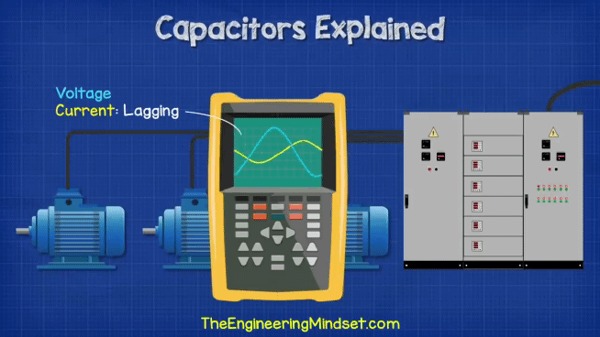
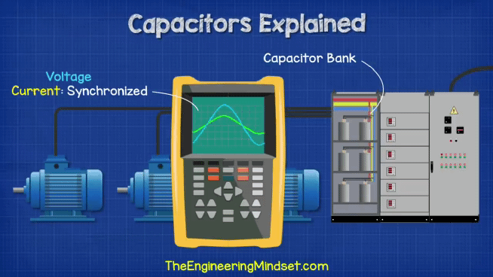
1
2
One of the most common application of capacitors is for power factor correction.
When too many inductive loads are placed into a circuit the current lags behind the voltage ⚡. We the use capacitors banks to counteract this and bring the two back in alignment
(Please view in slideshow)

Slide 26
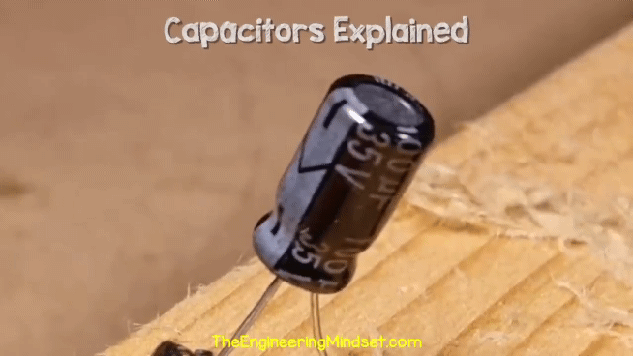
Every capacitor is rated to handle a certain voltage. If we were to exceed this then the capacitor will exploid .
(Please view in slideshow)

Slide 27
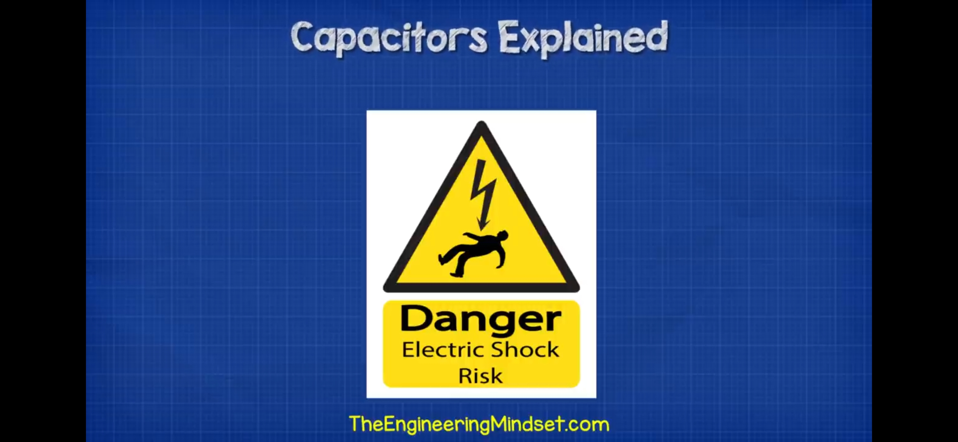
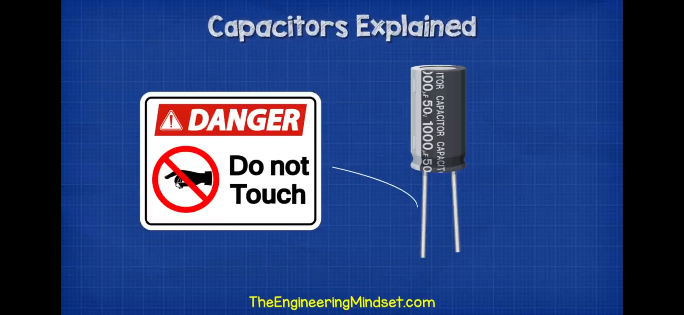

Slide 28
SOURCES USED
THE ENGINEERING MINDSET (BOOK)
THEENGINEERINGMINDSET.COM
BYJUS.COM
TOPPER.COM
INTERNET
ABC OF PHYSICS (SATISH K. GUPTA)
FRIENDS AND TEACHERS

Slide 29
THE CELL DISTURB THE ELECTRIC FIELD,OR GIVES IT A CERATIN IMPULSE. DO NOT ASK IN WHAT MANNER: IT IS ENOUGH THAT IT IS A PRINCIPLE, AND A GENERAL PRINCIPLE
~ALESSANDRO VOLTA
THANK YOU

